Slide 1
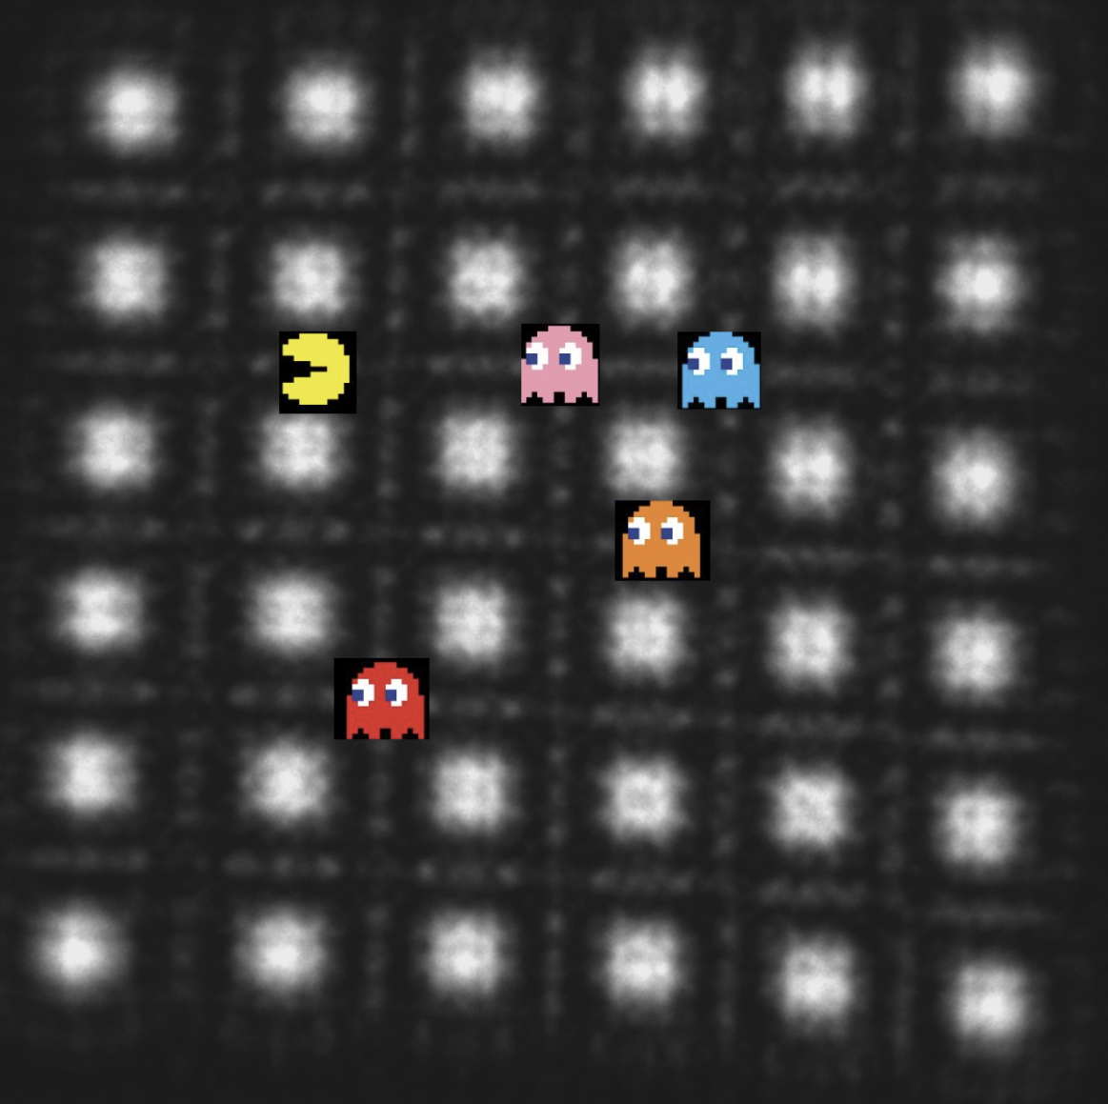
Beam-shaping in the TEM
Zen and the art of wavecrafting
J. Verbeeck
EMAT
University of Antwerp
Belgium
Now with free software
Check it out!
Notes:
1h talk, 15 min questions, 15 min tutorial
Practical…

Slide 2
Outline
Introduction to phase shaping
General concepts of waves
Some peculiar species in the wave zoo
The toolset of an e-wave crafter
Why would the sample care?
Conclusion

Slide 3
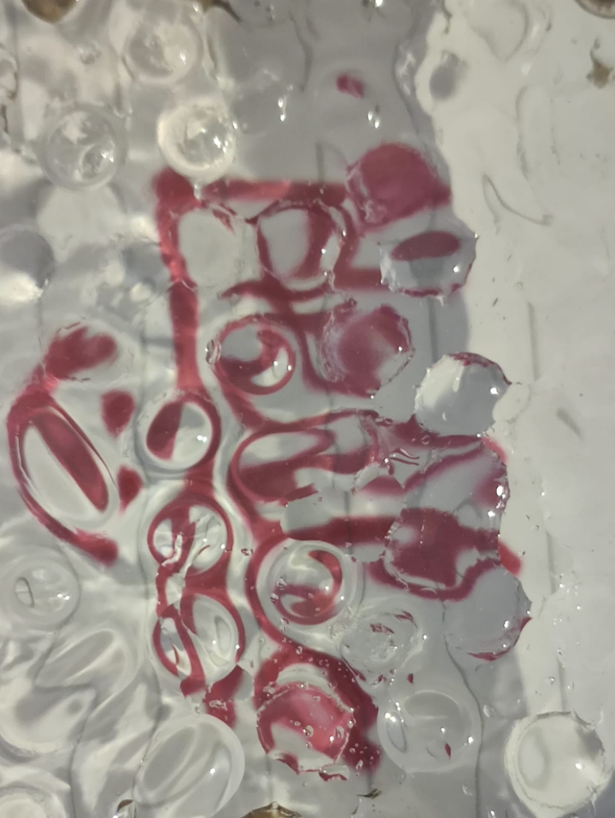
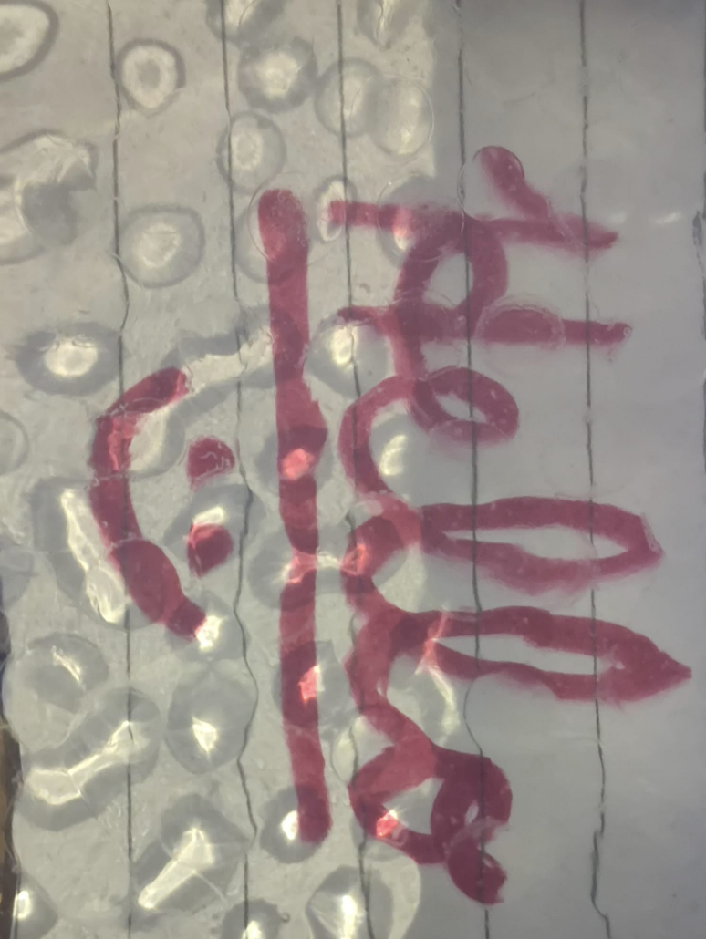
Notes:
In terms of adaptive optics I learned a lot from discussions with Hannes Lichte and his team on countless meetings and workshops
One of the ideas that stuck to me and that according to Hannes came from Gabor himself is the showe glass that you see imitated here by my my student Francesco
We see a message of written text through a polycarbonate plate with droplets of glue that act as little lenses and completely scramble the message.
That is to say, the full message is still there, it is just phase distorted and hard to read.
If we now poor water over this plate than we effectively create a complex conjugate lens that undoes the action of the glue droplets and magically the message appears.
This works in this case statically but if the glue were alive and bubbling (like e.g raindrops on a windshield) we would need some active compensation or adaptive optics
In my opinion this shows really well why arbiratraliy shaping a wavefront has lots of potential

Slide 4
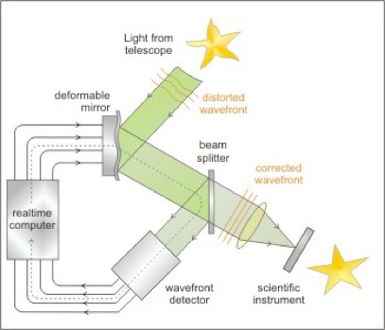
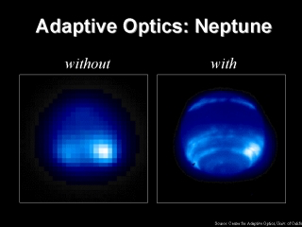
Phase manipulation?
Notes:
To start the talk: lets take a look at what phase manipulation is
A nice way to introduce the concept is with adaptive optics in astrophysics
Fluctuations in the athmosphere lead to distorted wavefronts coming from stars making distorting the image of such a star in the same way as how aberration in the electron microscope make a stem probe larger than desired. This leads to the fact that really large telescopes on earth are severely limited by this phenomena and are typically placed in high arreas with a thin and stable attmosphere.
Recently it has become possibe to correct for these deformed wavefronts with deformable mirror and a so-called wavefront sensor…such deformable mirror is one way in which it is currently possible to change the wavefronts of light at will

Slide 5
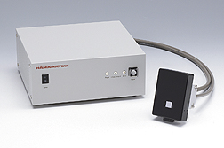
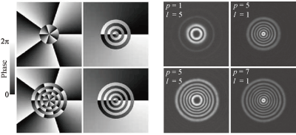
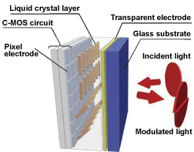
SLM: Spatial light modulator
In optics: freely programming phase is a reality
Notes:
So lets take a look at optics where a the beautiful device of SLM exists. This is a freely programmable phase plate that provides e.g. 1 Mpixel of freely programmable phase shifters which can have say 256 phase levles between 0 and 2pi.
In most cases it acts as a mirror and can be connected to a simple computer acting as a screen.
Here is an example of a set of Laguerre Gaussian modes which have a certain orbital angular momentum and a certain radial function creating a class of vortex modes
800x600 pixels with 256 phase levels

Slide 6
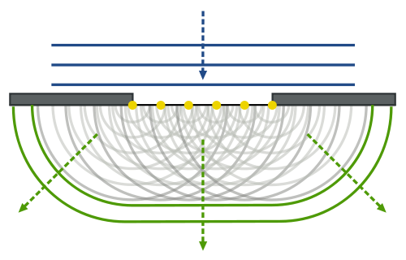
Huygens principle
Any wave can be represented by a collection of spherical sources with a certain amplitude and phase
Far away from these source we can treat them as plane wave.
So: a collection of plane waves can express any kind of monochromatic wave
Notes:
A very useful way of understanding the role of phase in coherent optics is the Huygens principle
Spherical waves…become plane waves in the far field..this also means that far field is ft of plane
Also see difference between near field and far field

Slide 7
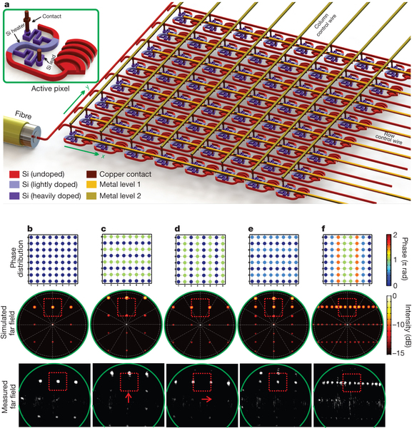
Coherent phased array
Jie Sun, Erman Timurdogan, Ami Yaacobi, Ehsan Shah Hosseini & Michael R. Watts
Nature 493, 195–199 (10 January 2013) doi:10.1038/nature11727
Notes:
A different way of achieving something similar is shown here. In stead of a mirror or phase shifter here the source of light itself consists of many coherent emitters that can be phase tuned with respect of each other
This leads to a source of light with a fully programmable wavefront from the launching of the wave
Some cool things are possible with this like a flash light with a rocking beam without any moving parts
Note how similar things have been used in radar technolgy to make sweeping radio waves but now things have miniaturised so much that this is also possible with visible light, without any real optical elements

Slide 8
Fraunhofer diffraction
When screen is very far away
Or when a lens is used to bring infinity to the focal plane
The pattern is given by the Fourier transform of the mask
This is in agreement with Huygens principle (when screen is at infinity)
Makes it easy to interpret the link between pattern and mask

Slide 9
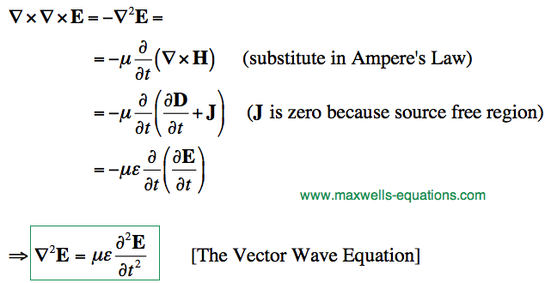
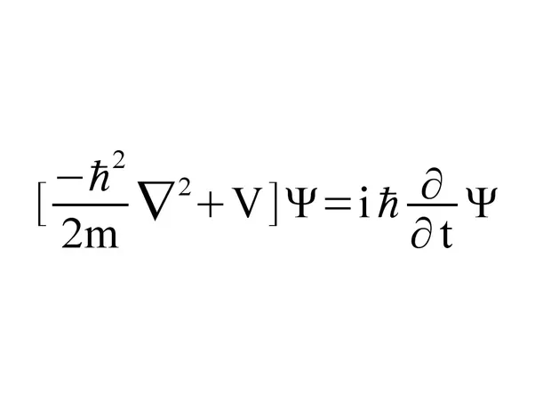
Helmholtz vs. Schroedinger
Schroedinger equation
Plane waves are a natural solution
But superpositions allow for wide variety of waves
Notes:
Huygens principle is coherent optics, what has this got to do with electrons?
From Maxwell we can derive the so called Helmholtz wave equation
The Laplacian of the space and time dependent electric field is equal to the double derivative of the field wrt to time.
A plane wave is a natural solution and we see light as plane waves
If on the other hand we look at schroedinger equation that describes quantum physics for eg an electron we see a similar laplacian and this time a single time derivative
Also here a plane wave is a natural solution in free space.
Bottom line is that both optics and electron wave are governed with very similar equations which leads to most things that exist in optics can also be done with electrons

Slide 10

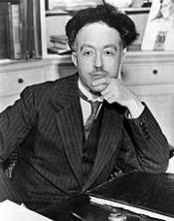
Electron wavelength
At 300kV, v~0.78c, lambda=2 pm
Notes:
One peculiarity of electrons is their wavelength that depenpds on their velocity
But most importantly this wavelength is far smaller than for visible light optics…eg 2pm at 300kV
But note that even at 100 eV we are still in the 1 angstrom regime which shows that high tension in tem is not essential to get high resolution and even very slow electrons have vastly smaller wavelengths as visible light or even X-rays

Slide 11
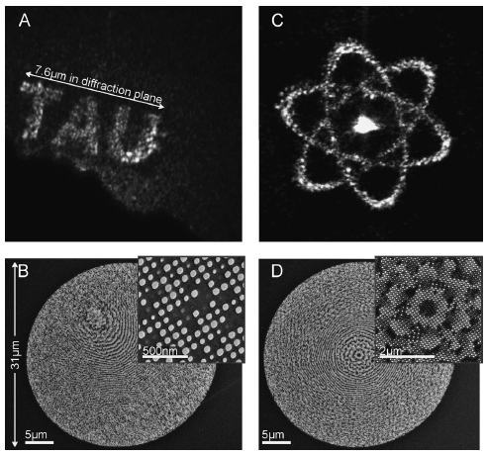
Is phase alone enough?
Via computer generated holography (CGH) a phase or amplitude only pattern in reciprocal plane can be used to create an approximation of the desired phase in the image plane
e.g. Fienup Optical Engineering 1980, or Gerzberg Saxton Optik 1971, Golub….
See also Noise shaping/ dithering/ …
Notes:
You could wonder if tuning the phase alone is enough to get full control over a wave. It turns out that if either amplitude or phase control is possible one can mimic a desired wave in the far field of the manipulator to a pretty high accuracy making use of typically itterative algorithms like the ones described for the inverse problem in electron diffraction, G Saxton and Fienup…in other fields of science these algorithms are known as dithering or noise shaping ….

Slide 12

Circular aperture (normal STEM)
All beams
https://github.com/joverbee/qem_tutorial
Check it out and have fun!
$$d50=λ/α$$
Diffraction limited probe
Notes:
Lets start with the most common wave in a modern stem
Take a round aperture and choose a flat phase
This leads to a focused probe in the far field, which size is determined by lambda/alpha (same for light)
So the smaller you want to make this spot, the smaller the wavelength needs to be and the larger the opening angle.
Here is a huge difference between light optics and electron optics, typically alpha can only reach a few 10s of mrad with current lens technologies
So even though we start out with a very small wavelength, we can’t really use this due to the fact that we need to limit the angles because aberration will move the phase away from flat resulting in broadening of the beam
We can then simulate how this beam behaves as a function of z, away from the focal plane
We note a cigar shaped profile where the length in z is much longer than in xy…in fact the z length scales with 1/alpha^2
This is a pity if you want 3D information as it could allow to focus inside a thick sample, but alas that usually doesn’t work very well.

Slide 13
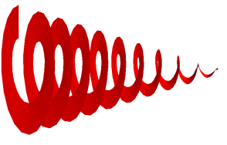
Vortices in waves
e^{ikz}
e^{iχ(x,y)}e^{ikz}
Continuous deformation of wavefronts
e^{ikz}
e^{ilφ}e^{ikz}
Phase singularity in center
l2π
Notes:
Lets take a look at wave optics
Suppose a plane impinging on some lens
The lens will deform the wavefronts in a continuous way
Wavefronts remain separate deformed planes that are not connected …we can describe this by a simple phase factor
Now imagine a special lens made like a spiral, and we take care that the phase difference at the step is a multiple of 2pi (a bit like a fresnel lens)
If a plane wave impinges on such a lens, the wavefronts will form a spiralling structure. Note that this is now a fundamentally different situation as above because the wavefronts are now all connected and there is a singularity in the center. Since the phase is undefined in this center the amplitude has to be zero (note there is no absorption still the amplitude is reduced to zero)
In mathemathical terms we say that this wave now has a different topology since you can’t go from this wave to the above wave without making a cut in the wavefronts
Such waves are called vortex waves (there are other signularities possible)…with a topological charge of l

Slide 14
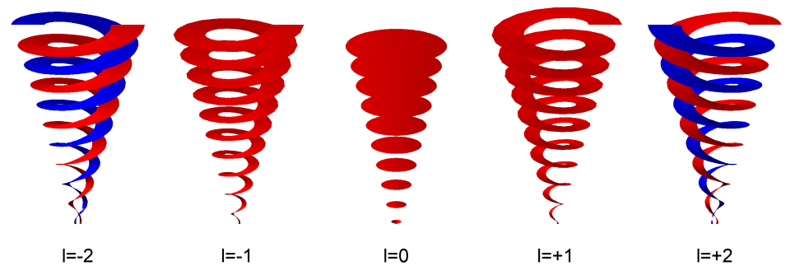
Vortex beams
helical phase=vortex beam
carries angular momentum lħ
topological charge l
OAM (vorticity)
vs. SAM (polarisation)
K. Bliokh et al., PRL 99 (2007) 190404
P. Schattschneider and J. Verbeeck (2011) Theory of free electron vortices., Ultramicroscopy. 111, 1461–8.
Notes:
Such vortex beams are also possible in the electron microscope and they form an interesting class of waves which can interact with a sample
They carry so-called OAM much like an orbital in an atom does but now in a propagating beam
For the occasion however I want to take a step away from vortex electron beams and explore the idea of what we could do in the TEM if we have a freely programmable phase plate?

Slide 15
Vortex waves (singular optics)

Slide 16

Size of a vortex beam
Verbeeck, Jo, Giulio Guzzinati, Laura Clark, Roeland Juchtmans, Ruben Van Boxem, He Tian, Armand Béché, Axel Lubk, and Gustaaf Van Tendeloo. 2014. “Shaping Electron Beams for the Generation of Innovative Measurements in the (S)TEM.” IF2013=1.639. Comptes Rendus Physique 15 (2–3): 190–99. doi:10.1016/j.crhy.2013.09.014.
$$d50=sqrt(m+1)λ/α$$

Slide 17
Non diffractive beams
Solution of 3D Helmholtz equation where wavepacket does not change upon propagation (propagation invariant optical fields)
Requires solution to be decoupled in transverse and longitudinal part
Cartesian (1D): plane wave
Circular cylindrical (1D): Bessel beams
Elliptical cylindrical (2D): Mathieu beams
Parabolic cylindrical (2D): Parabolic nondiffracting beams, Airy beams
Notes:
Plane waves are not the only nondiffractive solutions
…note that none of these can be realized in practice as energy arguments would have difficulty with a beam that fills the whole of space
In reality you can have only approximations to this, that even holds for the plane wave

Slide 18
Airy beams (bending light)
A non-diffracting beam! (unique in 1D)
Infinite power (in practice cut, they will diffract but slowly)
Berry, M. V.; Balázs, Nándor L. (1979). "Nonspreading wave packets". American Journal of Physics. 47 (3): 264–267. doi:10.1119/1.11855.
Siviloglou, G. A.; Broky, J.; Dogariu, A.; Christodoulides, D. N. (2007). "Observation of Accelerating Airy Beams". Phys. Rev. Lett. 99 (21): 213901. Bibcode:2007PhRvL..99u3901S. doi:10.1103/PhysRevLett.99.213901.
Notes:
Berry prediction, Sivioglou…first observation with optics
Only solution of the wave equation that is non-diffracting in 1D (apart from the plane wave)
In 2D there are more solutions
Phase that goes as the cube of position

Slide 19
Airy beam
Notes:
Beam that bends itself! Pretty counter intuitive
But note, the center of mass of the beam follows a straight line as it should because quantum mechanics should on average agree with classical mechanics

Slide 20
Bessel beam
J. Durnin, J. Opt. Soc. Am. A 4, 651 (1987);
J. Durnin, J. J. Miceli, and J. H. Eberly, Phys. Rev. Lett. 58 , 1499 (1987)
Notes:
Another interesting beam is the Bessel beam, it consists of a ring which theoretically should be infinitely thin
In that case you get a beam that doesn’t focus at all
The bigger the ring the more confined the probe is
The thinner the ring the closer you get to nondiffractive

Slide 21
Helicon beam
J E Morris, T Čižmár, H I C Dalgarno, R F Marchington, F J Gunn-Moore, K Dholakia, Journal of Optics 12-12 (2010)
Notes:
Variations on the theme
Note that superpositions of nondriffractive beam are not nessecaryl also non diffracting

Slide 22
Snake beam
J E Morris, T Čižmár, H I C Dalgarno, R F Marchington, F J Gunn-Moore, K Dholakia, Journal of Optics 12-12 (2010)
Notes:
Snake beam
Beam that seemingly jumps from left to right
Interesting thing of these nondiffracting beams is that they are said to be self-healing…if you obstruct part of the beam and propagate a bit further the beam will reconstruct itself

Slide 23

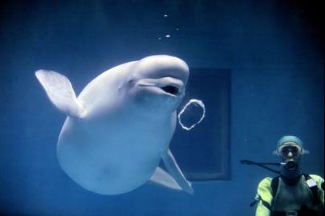
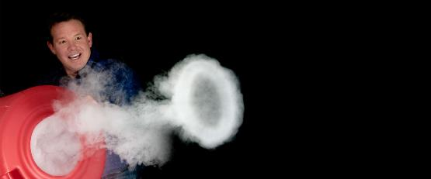
The toolset of an e-wave crafter
Notes:
But suppose you get all excited about these exotic wave, and since you are here you have access to a tem, how would you go about creating these?

Slide 24
Different strategies
E field
Magn. Vector potential
photons (Kapitza Dirac, ponderomotive force)
atoms (weak phase objects)
electrostatic lenses
electrostatic mirrors
RF fields (ponderomotive)
photons
magnetic atoms
electromagnetic lenses
electromagnetic mirrors
RF fields
exception:
selectively block electrons (holographic reconstruction)
Notes:
So lets take a look at the different strategies

Slide 25


Tuning the phase of electrons
AB phase, either magnetic or electric
Good news: control fields to control phase
Notes:
So if we stick to phase manipulation, how do we tune the phase of electrons…either by the AB phase shift or by passing through a region of space with an electrostatic potential different from zero…
Note how the magnetic phase is nicely independent of beam energy and therefore is attractive as phase shifter in times of microscopes that can freely change their HT values
Magnetic phase shift does not depend on electron energy!

Slide 26
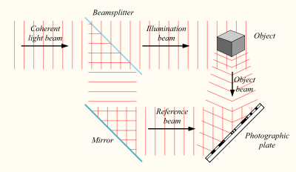
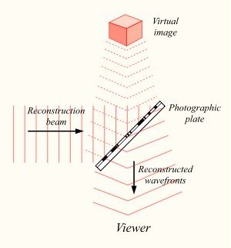
Tool 1: Holographic reconstruction
Conventional electron holography
All holograms
https://github.com/joverbee/qem_tutorial
Check it out and have fun!
Optical reconstruction: recreates the
Complex wave
Notes:
Another convenient way to create an arbitrary wave is via hplopgraphic reocnstruction

Slide 27
Example: making a vortex beam
+
=

Slide 28
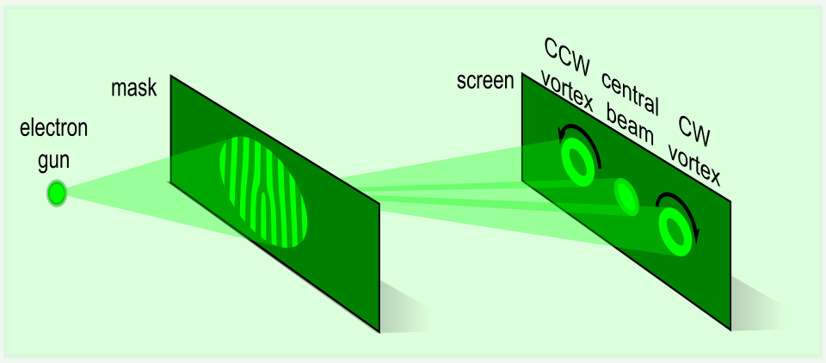
Hologr. reconstruction
Verbeeck, J. and Tian, H. and Schattschneider, P.,'Production and application of electron vortex beams', Nature 467(2010) 301-304

Slide 29
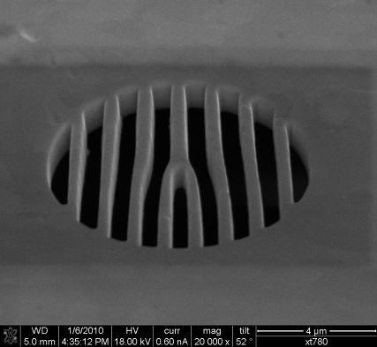
Realisation of vortex beams in TEM
l=+1
l=-1
28%
Practical realisation of vortex beams in TEM!
Many applications exist for optical vortex beams
Verbeeck, J. and Tian, H. and Schattschneider, P.,'Production and application of electron vortex beams', Nature 467(2010) 301-304

Slide 30
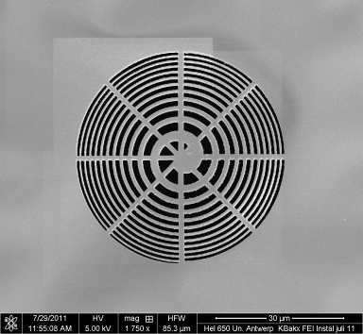
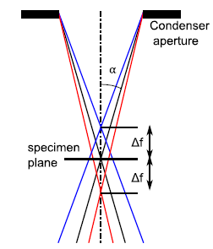
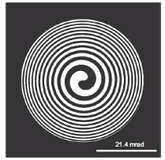
Alternative setup: Spiral
N.R. Heckenberg, R. McDuff, C.P. Smith, A.G. White, Generation of optical phase singularities by computer-generated holograms, Optics Letters 17 (3) (1992) 221–223.
Verbeeck, J.; Tian, H. & Beche, A. 'A new way of producing electron vortex probes for STEM’, Ultramicroscopy 113, (2012) 83-87.
Notes:
Total Lz=0 everywhere

Slide 31
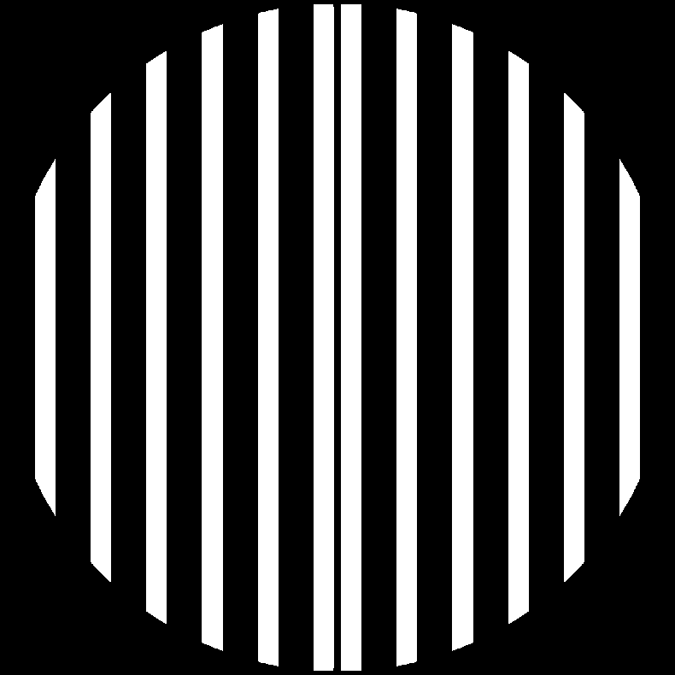
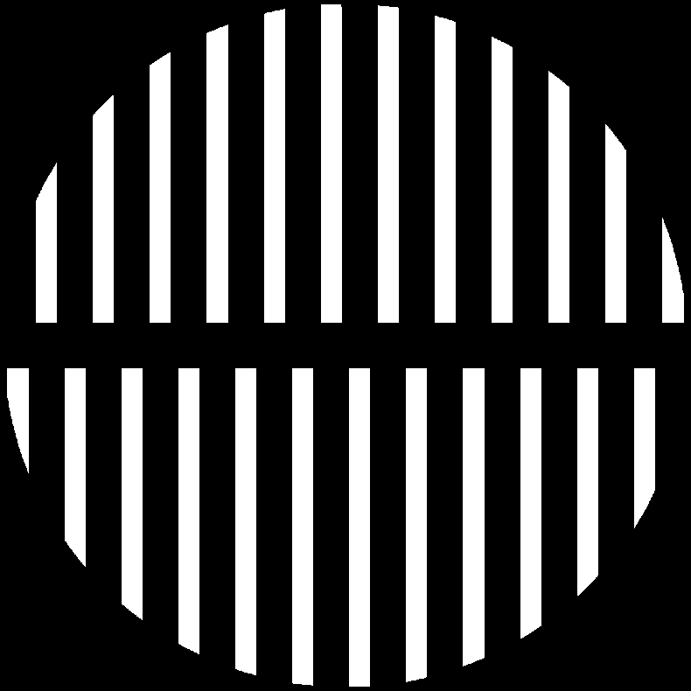
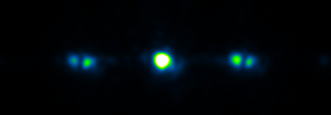
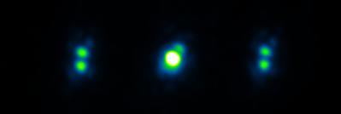
Holograms?
Notes:
Aperture size: 8um
Semi conv angle in uprobe stem: 0.8mrad
Probe size: ~10-15nm (they’re not round...)

Slide 32
Lets make an aberration corrector!
Can we use a neg Cs wave as desired wave?
Cs -1mm
Left beam is Cs corrected
Central is uncorrected (notice the gain!)
Right beam is Cs doubled
Cost=50$ (factor 200.000 lower than real corrector!)
Downside: unwanted beams, reduces intensity

Slide 33
Alternative with quadratic ref wave
Cs -1mm
-100,0,100nm defocus
Solved mostly the issue with sidebands

Slide 34


Tool 2: Aharanov Bohm effect
Purely QM effect, no forces involved

Slide 35
Tonomura experiment

Slide 37
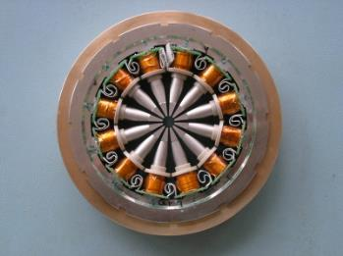
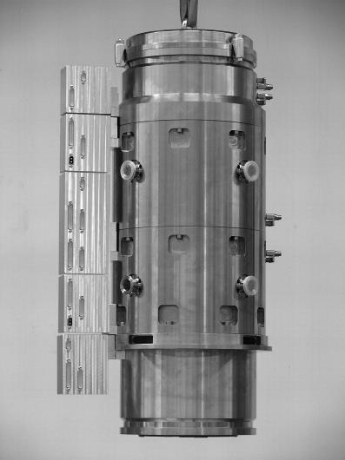
Example Cs/Cc corrector TEM
Haider-Rose-Urban legacy
Driving force behind nearly all progress in TEM since the 1990-ies
resolution ~20λ
M. Haider et al. Phil. Trans. R. Soc. A 2009;367:3665-3682
Notes:
Dodecapole lens: 12 currents to control gives flexibility in phase
Cc corrector of the TEAM1, combination of electrostatic and magnetic
demonstration 1994

Slide 38
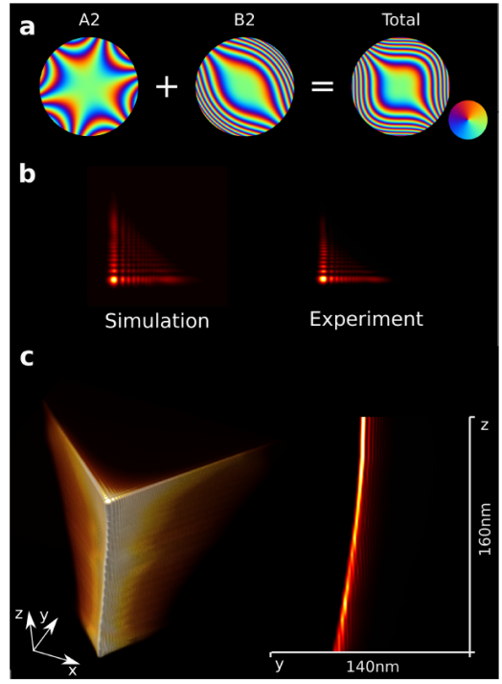
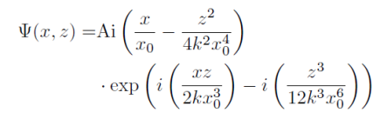


Airy wave
G. Guzzinati, L. Clark, A. Béché, R. Juchtmans, R. Van Boxem, M. Mazilu, and J. Verbeeck, “Prospects for versatile phase manipulation in the TEM: Beyond aberration correction,” Ultramicroscopy, vol. 151, 2015.
Notes:
B2 third order axial coma
A2 threefold astigmatism
Dependence of z is Airy function shifted by z^2 typical for accelerating particle

Slide 39
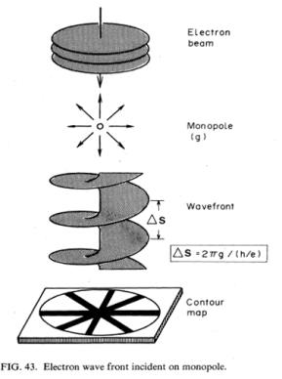
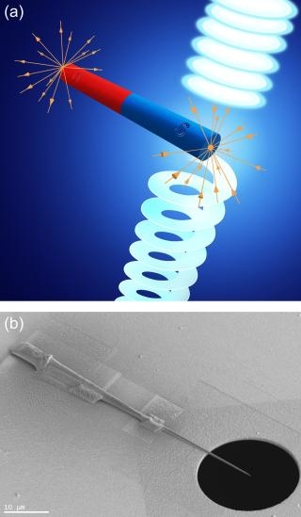
Using a magnetic monopole?
A. Tonomura, Applications of electron holography. Rev. of Mod. Phys. 59, 639-669 (1987)
A. Béché, R. Van Boxem, G. Van Tendeloo, and J. Verbeeck, “Magnetic monopole field exposed by electrons,” Nat. Phys., vol. 10, no. 1, pp. 26–29, Dec. 2013.
Notes:
Coming back to electron vortices we made use of the same magnetic AB effect to design a specific field with the symmetry of vortex. It turns out you need a magnetic monopole for that
But a long magnetic needle works almost as good as long as you let the electrons only interact with one end of the needle
But this is of course static…can we make it slighlty more programmable

Slide 40
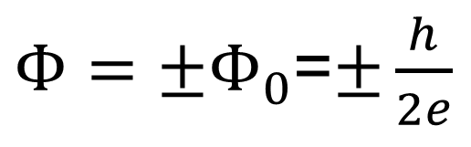
Aharanov Bohm phase shift
I. FIB preparation
m=+-1
requires a single flux quantum through the needle
$Φ=±Φ_{0}$=$±\frac{h}{2e}$
saturation field 2T would require cross section of 1000 nm²,
in fact we have 225x12 nm² active material
a flux quantum is not the smallest amount of flux
Notes:
In order to better understand the situaiton I made this schematic drawing
A ferromagnetic Nickel needle is placed in the field of the electron
Suppose we want to measure the phase difference between the red trajectory and a green than we know from the AB effect that this phase shift is proportional to the enclosed flux
If we now design the needle that the flux causes exactly a 2pi phase shift than we need to create a flux equal to a flux quantum
If we now displace the green trajectory there will be less enclosed flux if we move clockwise causing exactly the kind of phase ramp we need to make a vortex
make projection as small as possible
in Ni 60x250nm ^2, saturation field in Ni is 2T
flux quantum is 2e-15 Wb, area needs to be 1e-15m^2 or

Slide 41
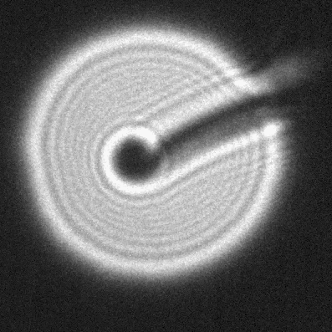
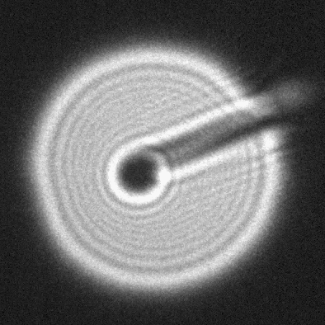
Dynamic vortex creation
it flips!
after a lot of tedious FIB work...
JV_Solenoid_06
Armand Béché
Stijn Van De Broeck

Slide 42
Image of the probe
In TEM mode, C3 on, the vortex is properly flipping for a 4.5A current peak.
26 nm shift appears upon flipping: silver paint or holder magnetization.
Left
Summed
6.1 nm
Right
Notes:
OUR silver paint is slightly ferromagnetic
The brass alloy we used contains 0.3% Fe and 0.3% Ni

Slide 43
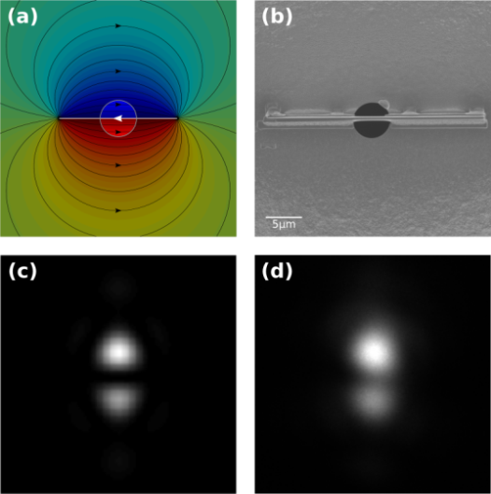
Pi beam with magnetic needle
Béché et al., Nature Physics, 10(1), 26–29 (2013)
Blackburn and Loudon, Ultramicroscopy, 136, 127–143 (2014)
Notes:
he
simulati
My talk is in session IM8-III running from 10:30 until 12:45 in the "Salle Bellecour 1,2,3"
And two portraits of my hairless head are attached.
on

Slide 44

Tool 3: refractive optics, MIP
Electrostatic AB effect
V gets projected along
trajectory
Exp(-I cte V)~ 1-I cte V + …
Weak phase object
Problems:
  phase contrast
  2D projection
Notes:
q/(hbar vz)=6e6, so Vl needs to be > 1e-6.
With typical V=10V thickness needs to be 100nm (?)

Slide 45
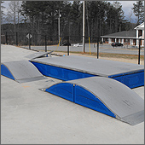
Projected potential
Final speed is same
But time delay depends on how long you stayed at higher potential
In fact the projected potential in the direction of motion
Remember:
True science and skateboarding are more closely related than you would think

Slide 46
TEM Phase Plate examples
N. Frindt, PhD thesis, “Development and implementation of electrostatic Zach phase plates for phase contrast transmission electron microscopy ”, University of Heidelberg, 2013 (http://www.ub.uni-heidelberg.de/archiv/14570 )
Notes:
Now also the Volta phase plate

Slide 47
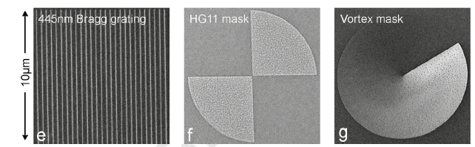
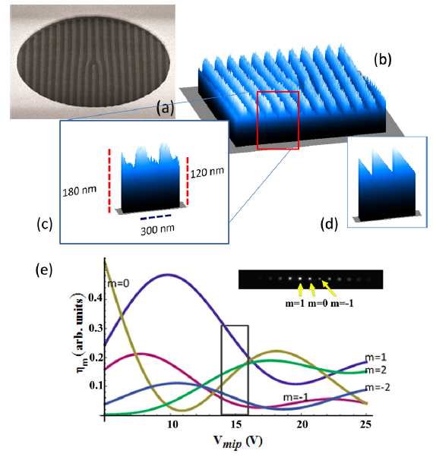
Phase plate based on MIP
R. Shiloh, Y. Lereah, Y. Lilach, and A. Arie (2014) Sculpturing the electron wave function using nanoscale phase masks, Ultramicroscopy. 144, 26–31.
V. Grillo, G. Carlo Gazzadi, E. Karimi, E. Mafakheri, R.W. Boyd, and S. Frabboni (2014) Highly efficient electron vortex beams generated by nanofabricated phase holograms, Applied Physics Letters. 104, 043109

Slide 48
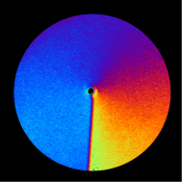
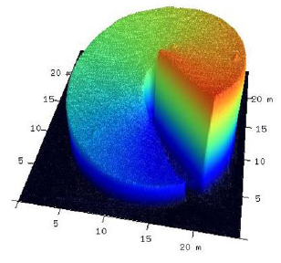
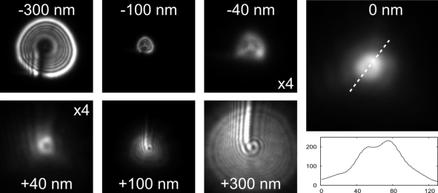
MIP based vortex mask
A. Béché, R. Winkler, H. Plank, F. Hofer & J. Verbeeck
Micron 80 (2016) 34–38
problems: thickness depends on HT, contamination, charging

Slide 49
A refractive Cs corrector?
arXiv:1705.05232
Shiloh, Roy, Roei Remez, and Ady Arie. 2016. “Prospects for Electron Beam Aberration Correction Using Sculpted Phase Masks.” Ultramicroscopy 163. Elsevier: 69–74. doi:10.1016/j.ultramic.2016.02.002.

Slide 50
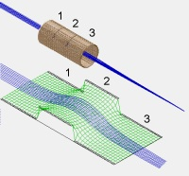
Tool 4: Einzel lens
Zach phase plate
Boersch phase plate
http://simion.com/info/lens.html
Majorovits, E., B. Barton, K. Schultheiß, F. Pérez-Willard, D. Gerthsen, and R. R. Schröder. 2007. “Optimizing Phase Contrast in Transmission Electron Microscopy with an Electrostatic (Boersch) Phase Plate.” Ultramicroscopy 107 (2–3): 213–26. doi:10.1016/j.ultramic.2006.07.006.
Schultheiss, Katrin, Joachim Zach, Bjoern Gamm, Manuel Dries, Nicole Frindt, Rasmus R Schröder, and Dagmar Gerthsen. 2010. “New Electrostatic Phase Plate for Phase-Contrast.” Microscopy & Microanalysis 16 (6): 785–94. doi:10.1017/S1431927610093803.

Slide 51
A 2x2 programmable phase plate
J. Verbeeck, A. Béché, K. Müller-Caspary, G. Guzzinati, M. Anh Luong, M. Den Hertog, Ultramicroscopy 190, 58–65 (2018) and https://arxiv.org/abs/1711.11373
Notes:
Quite a while ago we took this one step further and created an array of 2x2 of such lenses and showed that this could form a rudimentary programmable phase plate for electons
By showing the coherent interference of the 4 beams into a diffraction pattern that subtle depends on the state of the wave shifters.
In the defocused state as seen at the bottom this is more obvious where we still see the 4 separate patches either constructively or destructively interfering.
We wee vey excited about this, but clearly compared to an optical phase modulator, only 4 degrees of freedom is quite limiting in order to e.g. create these Hermite Gaussian basis sets we started of with,

Slide 52
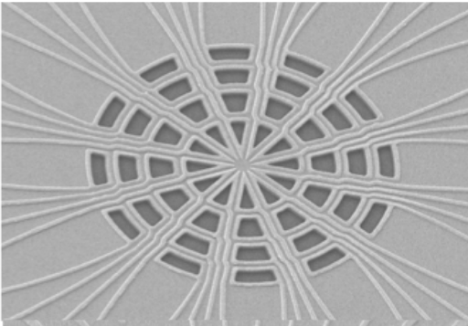
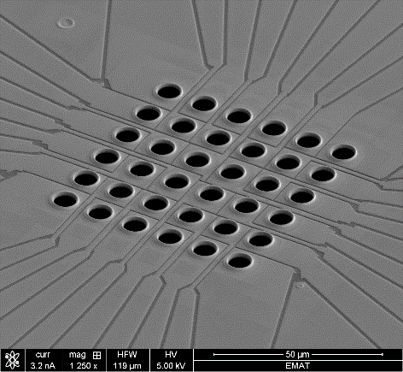
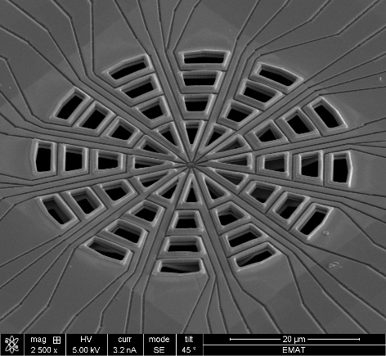
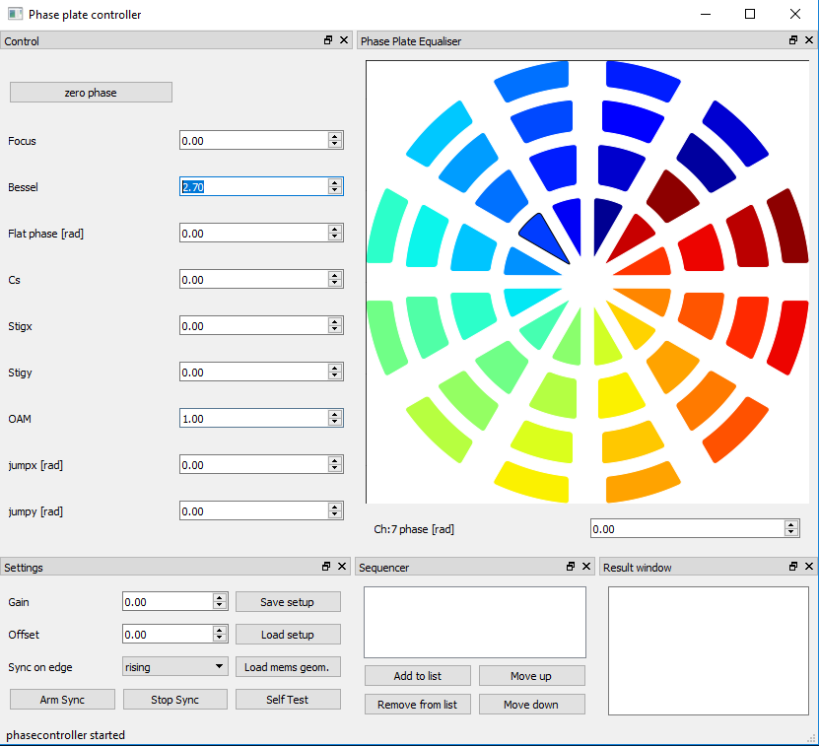

Upscaling: easier said than done
eBEAM litho approach
Hybrid photolitho/FIB approach provides more flexibility
Electronics
Software firmware +UI
Mechanics (how to fit so many connections in thight space?)
Notes:
So we started to upscale this prototype, and in honesty this turned out to take quite a bit longer than expected
We created different variants in terms of pixel pattern and in terms of lithograhpic methods producing them, working with ebeam litho and hybrids of photolitho with FIB reworking for the finer features. We settled on a design which can have up to 48 pixels and focus for now on so-called segmented or cartesian shapes.
We developed the electronics and software to drive these as well as the mechanics to put these in the condensor plane of existing microscopes.
Each of these steps is challenging in view of the very limited space, and vacuum requirements,
So lets look at some results…

Slide 53


Result in sample plane: cartesian grid
Phase calibration at 200 kV
simulated
Gain 0.00
Gain 0.01
Gain 0.02
Gain 0.03
Gain 0.04
Gain 0.05
Gain 0.06
Gain 0.07
Gain 0.08
Gain 0.09
Gain 0.10
Gain 0.11
Gain 0.12
Gain 0.13
Gain 0.14
Gain 0.15
Gain 0.16
Probe shape
π shift at 200mV
Notes:
Here we show some results on a cartesian grid design placed in the sample plane of a TEM and where we control pixel with index 3,3 with an increasing voltage.
You see how the slighlty defocused image of the grid causes an interesting inteference pattern which is highly sensitive to the phase relation of the different parts of the beam
When increasing the voltage you see that we can go from constructive to destructive to constructive interference
This allows us to callibrate the device and we find pi phase shift coincides with 200mV applied on that pixel, we can simulate this to model all the features
I we focus this pattern to a probe we get a sort of diffraction pattern from a regular grid, with a bright central probe, but quite strong diffraction tails from the periodicity of the grid. Using this for imaging would suffer from such tails and we shift no to a less periodic arrangement

Slide 54


Move to C2 plane: running pixel demo
24.6% fill factor
experiment
theory
0.8 mrad opening angle
300kV
Microprobe mode
Notes:
The polar grid,
This time we move to the C2 plane in a Titan microscope and we do a so-called running pixel demo where we sequently put each pixel to pi
You can see how this subtly changes the defocused pattern of the phase plate, we can also simulate the pattern and see a very similar behaviour, which strangely reminded me of one of those radial engine you see in vintage airplanes
Note that the fill factor here is only about 25%, we will come back to that in a minute

Slide 55

Beam shaping
0.8 mrad opening angle
300 kV
Microprobe mode
Notes:
At least a few of the Hermite Gaussian and a Laguerre Gaussian mode are easy to obtain with this desgin
You can clearly see that things are not perfect yet, but the symmetry of the probes really starts to appear

Slide 56
Tool 5: ponderomotive force
Path of electron in oscillating optical field becomes also a meandering path
The average forward speed of the electron doesn’t change
But the path length is now long as the trajectory was meandering
This depends on the amplitude of meandering and is proportional to E^2
Assumes a gradual entry and exit of optical field (so that average field remains zero)
Does not depend on direction of E field (polarisation)
Does not require a standing wave per se
Force relates to gradient of this phase
Electrons are expelled from intense photon field regions
This is an elastic effect (energy of electron is preserved after leaving the field)

Slide 57



trajectory
E(t)
v
Use same way as MIP (but no material)
Simulation of e-path through Gaussian laser beam of 100W with 1um beam waist. Amplitude ~ 7pm

Slide 58

Kapitza Dirac
Jonathan Handali, Pratistha Shakya, and Brett Barwick, "Creating electron vortex beams with light," Opt. Express 23, 5236-5243 (2015)
10^11 W/cm^2
P. L. Kapitza and P. A. M. Dirac, “The reflection of electrons from standing light waves,” Proc. Camb. Philos. Soc. 29 (02), 297–300 (1933).
Notes:
attractive as no material is needed, but needs standing wave which also limits flexibility and high power!

Slide 59

Tool 6: mirrors?
compensate bad lenses with equally bad mirror
target for 5eV LEEM 2λ
=1 nm

Slide 60
Why would the sample care?
In most cases it doesnt! (probability depends on intensity, not phase)
But interaction can often be expressed as a product of the beam wave function and a complex scattering amplitude
Bring selectivity in a measurement because the exit wave now travels towards a detector and the phase DOES influence WHERE the detected intensity ends up
Examples:
  pi-beams: equivalent of optical polarisation for plasmon response
  Vortex beams: local magnetism
  Bessel beams: high depth of field
  In ptychography we can exploit the known phase of the beam to get a better estimate of the unknown phase of the sample
  Higher contrast in life science imaging

Slide 61

Mapping phase in plasmons?
G. Guzzinati, A. Béché, H. Lourenco-Martins, J. Martin, M. Kociak, and J. Verbeeck, “Probing the symmetry and phase of localised surface plasmon resonances with singular electron probes,” Nature Communications 2017. http://arxiv.org/abs/1608.07449
Notes:
So why not apply exactly the same reasoning that lead to the magnetic mapping with vortices but now for an object which is fundamentally larger and therefore suffers less from source size broadening….moreover plasmons are much more probable excitation as compared to core loss excitions so also the signal to noise issue will likelky by much more favourable
so here we propose a totally new setup in which we will prepare an incoming probe with the same symmetry as the mode we want to excite..
combingi this with post selecting along the forward direction we can see in this sketch what would happen for a dipolar mode sketched here
if we park a conventional beam on the center we have an even function interacting with an odd interaction matrix leading to an odd partial exit wave
and therefore a zero in the intensity in the forward direction
if however we make an odd probelike a p-orbital…we tend to call it a pi-wave
then odd and odd symmty match and an even partial exit wave is generated leading to intensity on the optic axis
rotating the probe by 90 degresss again destroys the symmetry maths and leeds again to no intensity
note that the paper describing this in detail is avialable since yesterday on Arxive
Phase modulation at atomic scale is highly challenging due to source size broadening/ resolution and scattering inside crystal
Why not take a step back and look at excitations on a bigger scale: surface plasmons
note that there was some work on this by the Lichte group using holography and energy filtering
note also that phase and inelastic scattering DOES NOT influence the scattering probability, but it does influence where the electrons end up and therefore if we choose a small collection angle we can get selectivity.

Slide 62

Experiment
G. Guzzinati, A. Béché, H. Lourenco-Martins, J. Martin, M. Kociak, and J. Verbeeck, “Probing the symmetry and phase of localised surface plasmon resonances with singular electron probes,” Nature Communications 2017. http://arxiv.org/abs/1608.07449
Notes:
an if we then look at the spectra on an alluminum rods we see a tremendous difference in on axis EELS spectrum when measuring on axis between or pi shape probe parked in the center of the particle or a normal probe…with the normal probel selecting only the symmetry of the quadrupole mode while the pi beam selects the dipole exctitation
this simple example shows that phase matching in inelastic scattering works amazingly well and that most liey the issues we are facing for the magnetic mapping are due to instrumentation imperfactions rather than fundamental as demonstrated by this easier demonstration
it brings the selectivity of linear polarisation to STEM EELS plasmonic mapping with the added bonus of allowing much more freedom in the symmtry selection alsotargetting quadrupole or higher modes which is impossible with light.

Slide 63

Conclusion
There are many different ways to craft an electron beam
There are many unexplored electron beams and interactions waiting for you!
I provided you with a jump start and software to get you going
Use your imagination and go explore

Slide 64

Tutorial

